Slide 1
The Eternal War in Memory
Presentation By: Darrel Belen

Slide 2
Introduction
Memory corruption bugs are some of the oldest problems in computer security
Lack of memory safety leads to exploitable attacks
Unrealistic to simply avoid low-level languages
The “War in Memory”
Offensive: Develop new attacks
Defensive: Develop new protections and safe programs

Slide 3
Motivation
C/C++ prone to memory corruption bugs
Enables attackers to exploit these bugs
Systemize and evaluate previously proposed approaches
Systemization: create a general model for vulnerabilities
Evaluation: Robustness, performance, and compatibility
Identify main approaches

Slide 4
Contributions
Develop a general model of memory corruption attacks
Clarify what attack vectors are left unprotected
Evaluate/compare proposed solutions for various factors
Discuss why proposed solutions are not adopted in practice

Slide 5
Technical Details

Slide 6
Attacks
Memory Corruption
Code Corruption
Control-flow Hijack
Data-only Attack
Information Leak

Slide 7
Memory Corruption
Method used to carry out different types of attacks
Three Steps for Memory Corruption
Make a pointer invalid
Dereference the pointer
Corruption/leakage of internal data

Slide 8
Memory Corruption
Invalidate Pointers
Out-of-bounds
Point to deleted object (Dangling Pointer)
Dereference Pointer
Corruption/leakage of data
Read or Write data

Slide 9
Memory Corruption - Possible Outcomes
Attack may divert control-flow
Attack may leak information
Attack may perform memory reads/writes
Make a pointer point to a location under control of the attacker
printf(user_input); // user_input = “%3$x”
// prints 3rd integer on stack
printf("%s\n", err_msg); // memory content leak

Slide 10
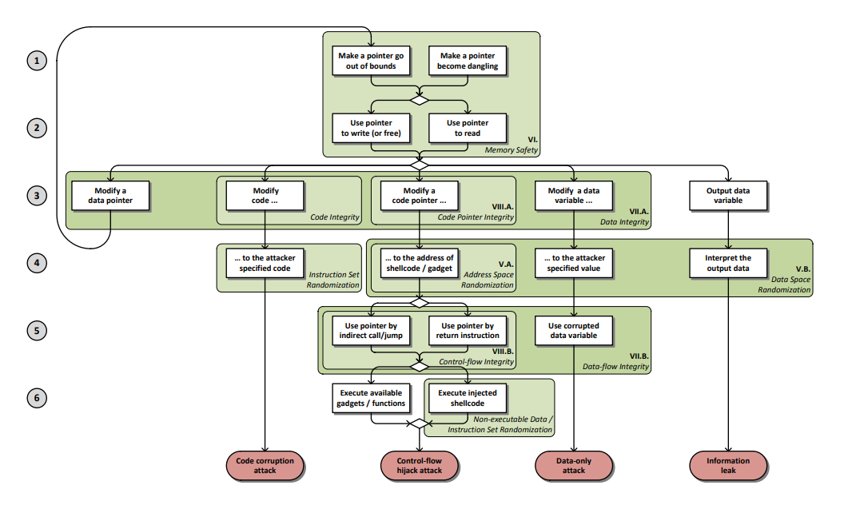
Memory Corruption - General Model

Slide 11
Defenses

Slide 12
Currently Used Defenses
Most Widely Used Protections
Stack Smashing
Data Execution Prevention (DEP)
Address Space Layout Randomization (ASLR)

Slide 13
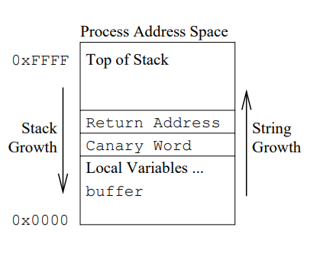
Currently Used Defenses
Stack Smashing (Stack Canary)
Detect buffer overflows which overwrite the saved return address
Place random value between return address and local buffers
Integrity of value can be checked

Slide 14
Currently Used Defenses
Data Execution Prevention (DEP)
Protect against code injection
Data can no longer be writable AND executable
Process terminated if there is an attempt to execute

Slide 15
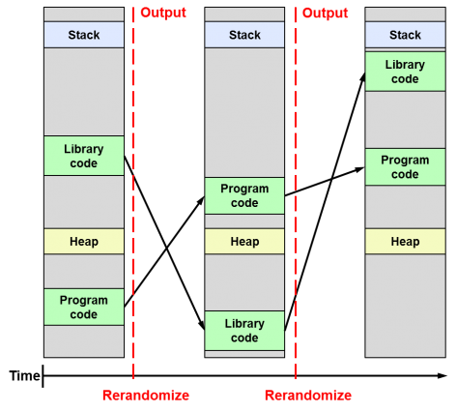
Currently Used Defenses
Address Space Layout Randomization (ASLR)
Make guessing addresses very difficult
Randomize address space locations

Slide 16
Approaches and Evaluation
Approaches
Probabilistic Protection
Deterministic Protection
Evaluation Criteria
Protection (Enforced Policy)
Cost
Compatibility

Slide 17
Evaluation
Protection
Enforced Policy (ex: Memory Safety or Data-Flow Integrity)
False negatives: probability of a successful attack is > 0
False positives: avoidance of false alarms (unnecessary crashes)

Slide 18
Evaluation
Cost
Performance overhead
Memory overhead
Compatibility
Source compatibility: unmodified source code
Binary compatibility: unmodified binary modules
Modularity: modules handled separately

Slide 19
Policies

Slide 20
Memory Safety
Enforcing this policy stops all memory corruption exploits
Complete Memory Safety achieved if both spatial and temporal errors are prevented
Spatial Safety
Complete spatial safety: keep track of pointer bounds
SoftBound as a potential solution
Temporal Safety
Object-based Approaches (Valgrind or AddressSanitizer)

Slide 21
Generic Attack Defenses
Data Integrity
Enforce spatial memory integrity
Focused on common attacks
“Unsafe” pointers
Data-flow Integrity
Detect corruption before it is used by checking instructions
Ex: Check write instruction on isAdmin variable

Slide 22
Limitations
Solutions may have some weakness to take advantage of
Proposed approaches have tradeoffs

Slide 23
Conclusion
The “Eternal” War in Memory
Focus on “bigger picture”
Less on specific attacks
Start with a general model, similar to Memory Corruption

Slide 24
References
Azana, D., 2017. Differences Between ASLR, KASLR And KARL | daniloaz.com. <https://www.daniloaz.com/en/differences-between-aslr-kaslr-and-karl/>
Cowan, Crispin & Pu, Calton & Maier, Dave & Hintony, Heather & Walpole, Jonathan & Bakke, Peat & Beattie, Steve & Grier, Aaron & Wagle, Perry & Zhang, Qian. (1998). StackGuard: Automatic adaptive detection and prevention of buffer-overflow attacks. 98. 5-5.
L. Szekeres, M. Payer, T. Wei and D. Song, "SoK: Eternal War in Memory," 2013 IEEE Symposium on Security and Privacy, Berkeley, CA, 2013, pp. 48-62, doi: 10.1109/SP.2013.13.

Slide 25
Thank you!
Any questions?

